Slide 1
Justice conference 2017
21st IEF Annual conference
Environmental Changes as forces for disintegration and integration
Laurent Mesbah

Slide 2
Changes and processes in Nature

Slide 3
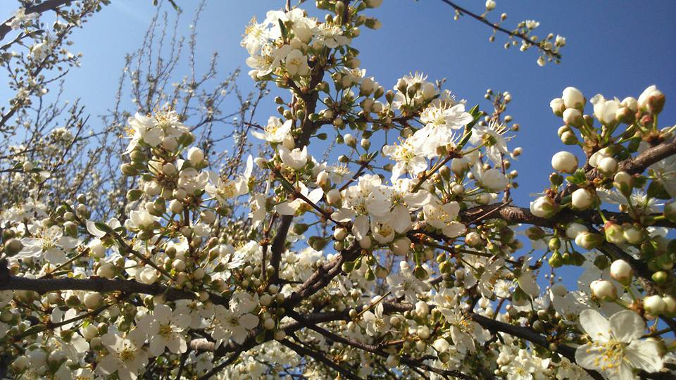

Slide 4
Nature offers beautifull examples of organic processes, with seasonal cycles
Spring is a physical rebirth of organic matter and life
Spring is a symbol of renewal or rebirth used in many cultures and old traditions maintained througout the ages.
This re-birth is part of a natural organic cycle which can be observed at different levels

Slide 5
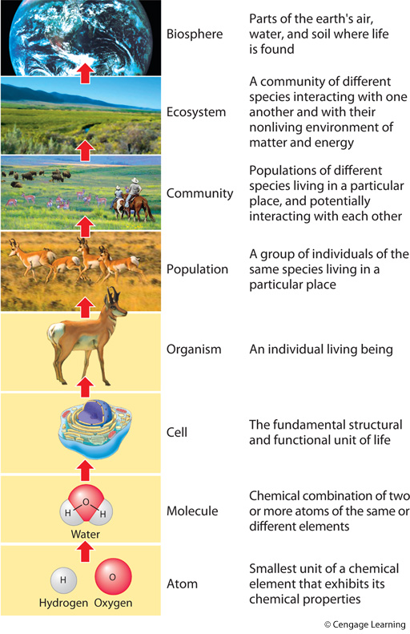

Slide 6
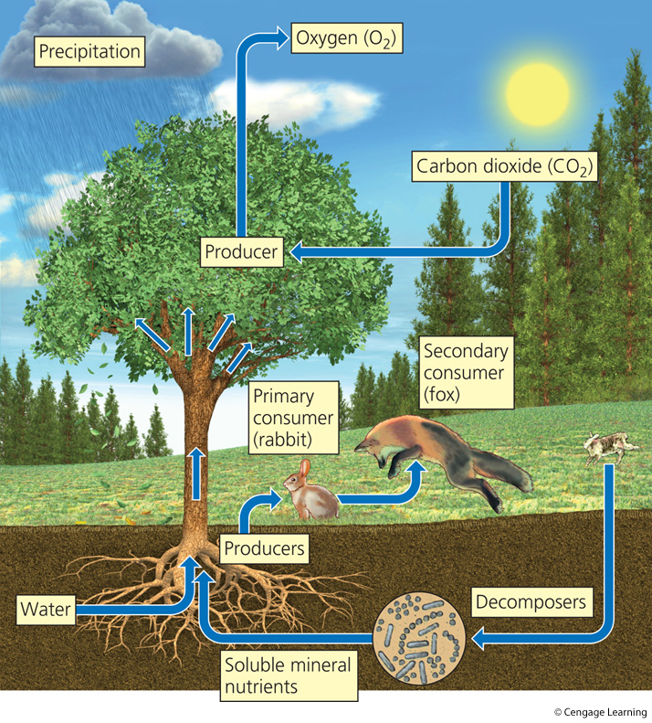

Slide 7
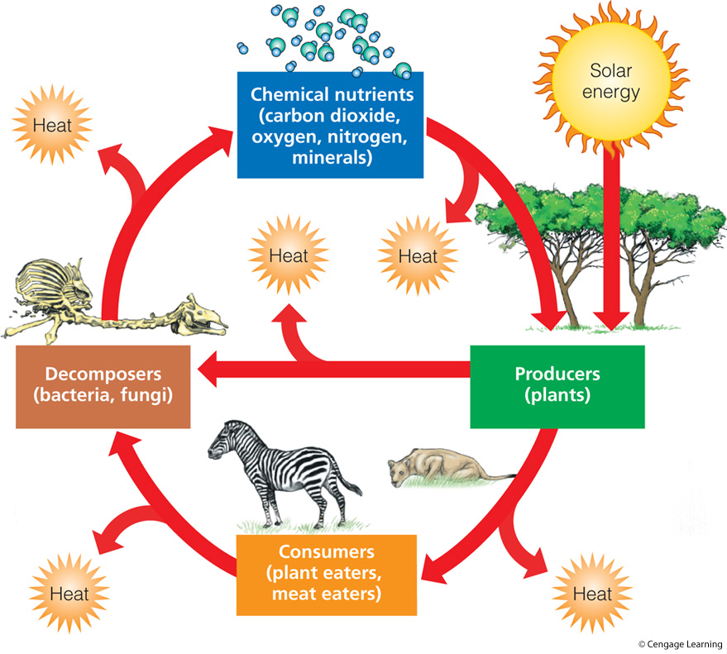

Slide 8
In nature integration and disintegration are strongly inter-connected
What can we say about human societies and these forces of integration and disintegration?

Slide 9
The disintegrating forces are very visible
Climate disruption, biodiversity loss, habitat destruction and unsustainable use of natural resoucres constitute a real crisis and threat for humanity and for many forms of life.

Slide 10
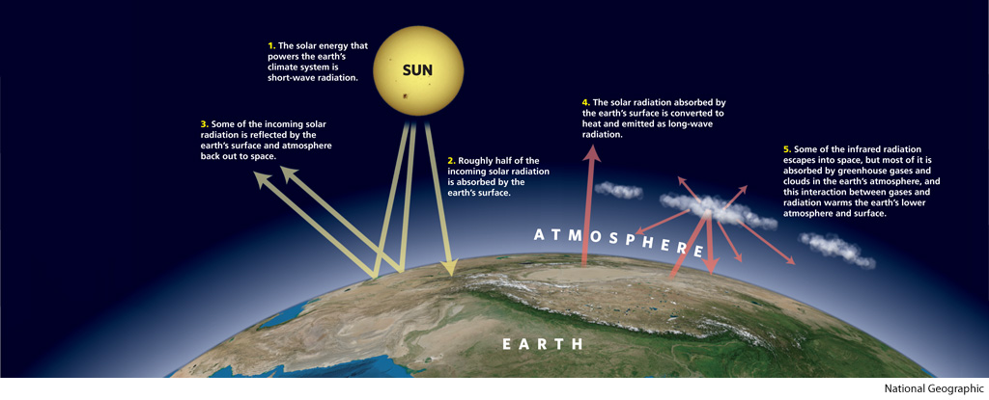

Slide 11
The disintegrating processes
Human societies themselves are facing many crisis such as inequalities, financial, social, and all kind of injustices today are adding to each other and seem to be interconnected.

Slide 12
Perhaps if we look at the root causes of these crises we could understand how these disintegrating forces can provide the driving forces needed to build more just and sustainble human societies in better harmony with their natural environment.
Where do we see the intergation processes ?

Slide 13
What can we (Humans) learn from these natural processes ?
Of course we are part of the food web and as such our physical bodies need to abide by the rules. Our body‘ s matter is also being recycled and we recive physical energy as first, second or third level consumers.
But what can we learn when it comes to the way our individual lifes, our communities, our societies are organised ?

Slide 14
What do we need for prosperous and harmonious societies ?

Slide 15
"There are spiritual principles, or what some call human values, by which solutions can be found for every social problem.
Any well-intentioned group can in a general sense devise practical solutions to its problems, but good intentions and practical knowledge are usually not enough. The essential merit of spiritual principle is that it not only presents a perspective which harmonizes with that which is immanent in human nature, it also induces an attitude, a dynamic, a will, an aspiration, which facilitate the discovery and implementation of practical measures. Leaders of governments and all in authority would be well served in their efforts to solve problems if they would first seek to identify the principles involved and then be guided by them."
The Promise of World Peace, The Universal House of Justice

